Slide 1
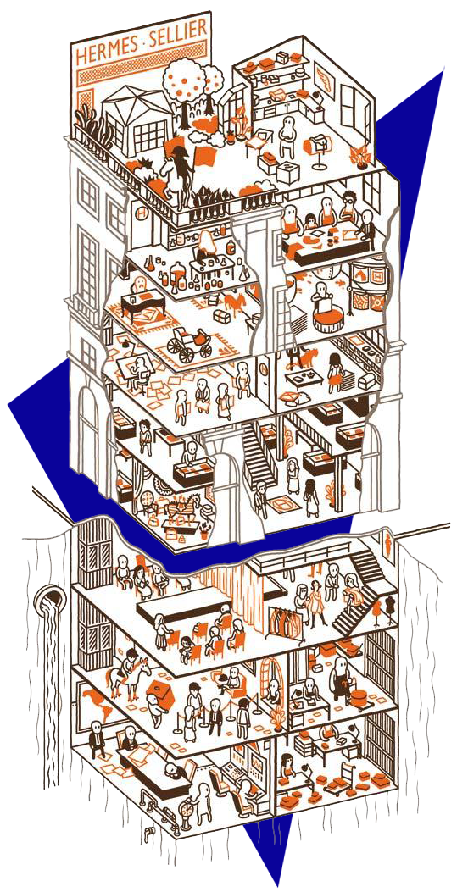
PROGRAM
ANALYSIS
Mariapia Sierra | Janine King & Esperanza Muino | Grad 2 | FIU

Slide 2

GOAL
STATEMENT
ESSENTIAL PURPOSE
The purpose of this workplace is to create an environment that symbolizes the exclusivity and elegance that represents Hermès, where a diverse community of workers can grow equally. This office is designed for workers to be able to engage, create small communities and to have their own privacy, if desired, by creating flexible spaces. This workplace will be a space that celebrates the values of the company and the well-being of the employees in order to boost moral in the workplace.
MAIN GOAL
Hermès is a brand rich in tradition that celebrates innovation and their love for craftsmanship.
The main goal for this workplace is to design a revolutionary space dedicated to the employees and their well-being. A space where the users are the main concern of the design while reinforcing the history and culture of the brand. One that allows the workers to interact with each other and possible clients. Where they can grow professionally with the brand while still being able to take care of their mental and physical health.

Slide 3
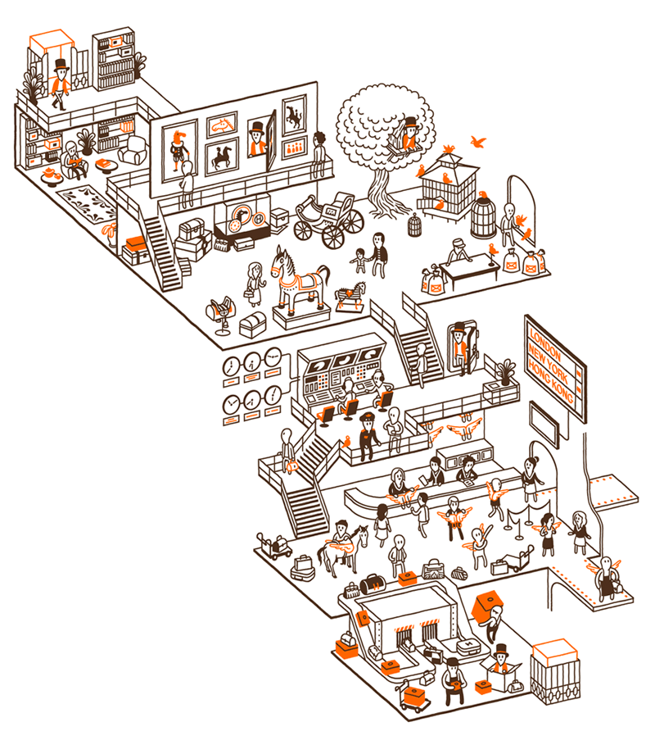
DOMINANT FEATURES
The workplace will be mainly public spaces on the first level and the more private ones on the second one. One of the ideas is to create a level exclusively for the executive suite that represents the hierarchy of the organization and at the same time will be available to the employees. Another important feature that will represent the brand is by exposing the structure as a celebration to craftsmanship and make the columns an important architectural fixture. The workplace will count with a big staircase that will serve as a connection of the two levels, create well-being by making people exercise and to use it as a point to create small communities. The workplace will also feature history facts of the brand and its values throughout their public spaces, such as the café, lobby and waiting area, corridors, etc. It will count with a daycare to allow equal amount of men and women workers and support their needs. All that while using the highest amount possible of sustainable materials.
CRUCIAL ASPECTS
In order to achieve a successful workplace for Hermès, the design and architecture fixtures have to speak to the grandeur that this luxurious brand represents, while in harmony with its surroundings. It will be space rich in history throughout the whole workplace to create a connection with the employee and give the sense of being part of a big family, while at the same time offers specific work spaces that will define hierarchy. It will take advantage of the amount of daylight that goes into the building and the view in order to encourage well-being and bring people closer to nature, and it will also challenge the structure in order to create a mix of flexible, private, and quiet spaces.

Slide 4
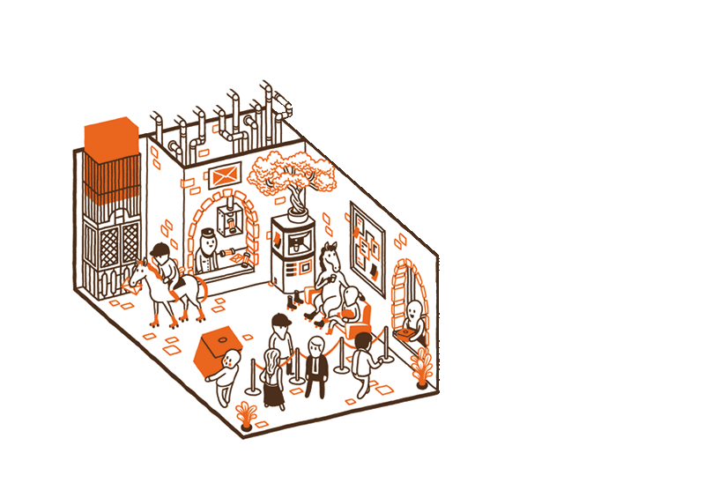

LOBBY
Reception and Waiting Area:
Product Display:
1
60 NSF
Capacity:
Quantity:
Area:
1
1
220 NSF
Quantity:
Area:
280 NSF
First impression of the company. Room that welcomes public from the outside to the inside of the workplace.
Receptionist is in charge of answering incoming calls, scheduling appointments and meetings, greeting visitors, and answer questions to guests. Waiting area is a large space where guest sits until event or appointment begins.
An interactive way to display the brand’s most desirable products and show the guests why Hermès is one of the most iconic brands until now.
Needs:
FF&E:
Proximity to restrooms, stairs, elevators, and café to offer guests while waiting. Acoustical privacy and task lighting for the receptionist to be able to perform her work.
Desk, long and personal couches, coffee and side tables, water and coffee station, outlets, lamps, phone, computer.
LOBBY
WAITING
AREA
STAIRS
CAFÉ

Slide 5
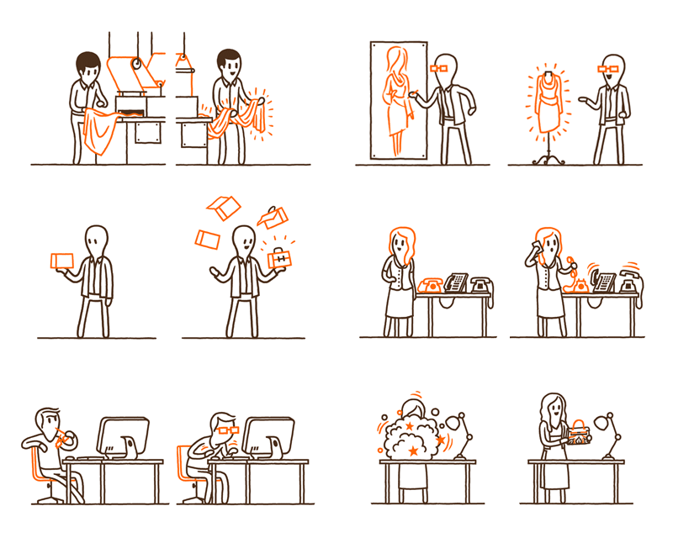
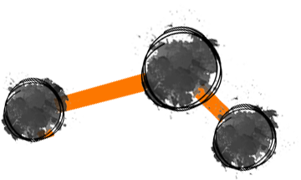
IT
Workspace:
Support:
1
1
150 NSF
2
18 NSF
Office:
3-Drawer Lateral Files:
Capacity
Quantity:
Area:
Quantity:
Area:
612 NSF
In charge of the day-to-day functioning of a company's computer network including organizing, installing, and supporting computer systems, networks, and other data communication systems.
A room used as a place for commercial, professional, or bureaucratic work.
Cabinets for storage
1
3
108 NSF
6
1
336 NSF
Workstation:
Computer Maintenance Room:
Capacity
Quantity:
Area:
Capacity
Quantity:
Area:
Desktop computer terminal
Space where personal keeps computers in good state of repair.
FF&E:
Needs:
File cabinets, desks, chairs, couch, coffee and water area, outlets, TV’s, computers, lamps, phone.
Space that can be easily reached by employees with the right amount of acoustic privacy. Task lighting.
IT
PRINT
SERVER
ROOM

Slide 6
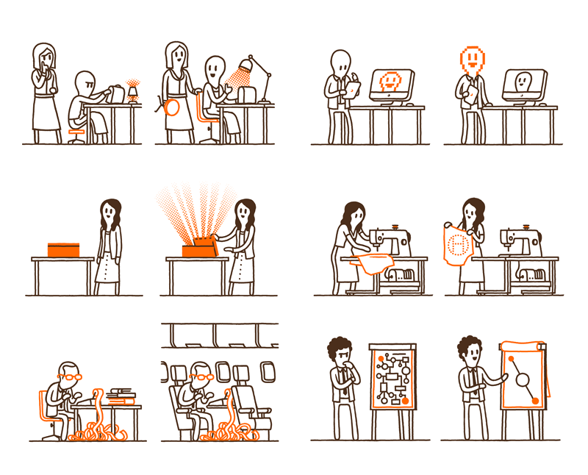
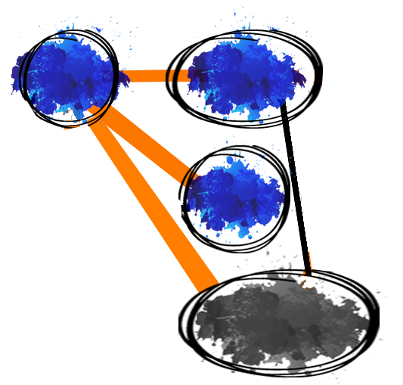
H.R.
Support:
Workspace:
6
54 NSF
1
1
150 NSF
3-Drawer Lateral Files:
Office:
Quantity:
Area:
Capacity
Quantity:
Area:
340 NSF
Cabinets for storage.
A room used as a place for commercial, professional, or bureaucratic work.
Human resource management is the strategic approach to the effective management of people in an organization, so that they help the business gain a competitive advantage.
1
1
100 NSF
1
3
36 NSF
Mother’s Room:
Workstation:
Capacity
Quantity:
Area:
Capacity
Quantity:
Area:
Private space where a nursing mother can use a breast pump.
Desktop computer terminal.
Needs:
FF&E:
Preferable to be located on the first level. Space easy for employees and possible new employees to find. Close to daycare area.
Desks, long and personal couches, workstation, TV, phone, file cabinets, nursing chair, refrigerator, water station.
LOBBY
WAIT
DAY
CARE
H.R.

Slide 7
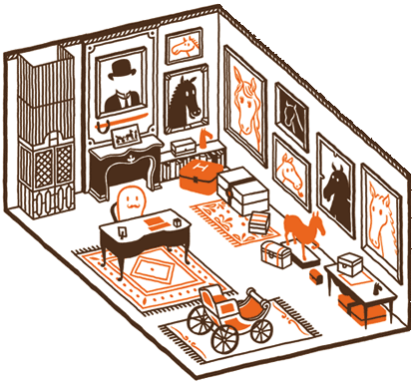

EXECUTIVE SUITE
900 NSF
Workspace:
Support:
1
2
834 NSF
2
18 NSF
Collection of offices, rooms, or suit used by the top managers of a business or the executives.
Executive Office:
3-Drawer Lateral Files:
Capacity
Quantity:
Area:
Quantity:
Area:
Used by the top managers as a place for commercial and professional work.
Cabinets for storage.
1
1
48 NSF
Workstation:
Capacity
Quantity:
Area:
Desktop computer terminal for executive assistant.
FF&E:
Needs:
File cabinets, desks, chairs, couch, coffee and water area, outlets, TV’s, computers, lamps, mini fridge.
Space reachable to clients and employees that defines hierarchy. Natural light, task lighting, comfortable furniture, acoustic privacy.
EXECUTIVE
SUITE
STAIRS

Slide 8

ACCOUNTING
604 NSF
Support:
Workspace:
6
54 NSF
1
1
150 NSF
3-Drawer Lateral Files:
Office:
Prepare and examine financial records. They make sure that records are accurate and that taxes are paid properly and on time.
Quantity:
Area:
Capacity
Quantity:
Area:
Cabinets for storage.
A room used as a place for commercial, professional, or bureaucratic work.
1
120 NSF
Storage Room:
Quantity:
Area:
1
6
216 NSF
Workstation:
Where furniture can be stored.
Capacity
Quantity:
Area:
1
100 NSF
Safe Room:
Quantity:
Area:
Desktop computer terminal.
Provides a safe shelter, or hiding place.
Needs:
FF&E:
Acoustical privacy. Proximity to Sales, Marketing, Operations, Purchasing, and Quality Control areas. Task lighting.
Desk, long and personal couches, coffee and side tables, water and coffee station, outlets, lamps, phone, computer, daybed, mini fridge, pantry.
OPERATIONS
PURCHASING
MARKETING
ACCOUNTING
SALES
QUALITY
ASSURANCE

Slide 9

OPERATIONS
501 NSF
Workspace:
Hoteling:
2
2
36 NSF
Office:
1
1
150 NSF
Capacity
Quantity:
Area:
It is the administration of business practices to create the highest level of efficiency possible within an organization. It is concerned with converting materials and labor into goods and services as efficiently as possible to maximize the profit of an organization.
Capacity
Quantity:
Area:
Short-term provision of office space to a temporary worker.
A room used as a place for commercial, professional, or bureaucratic work.
Support
1
8
288 NSF
3
27 NSF
Workstation:
3-Drawer Lateral Files:
Capacity
Quantity:
Area:
Quantity:
Area:
Desktop computer terminal
Cabinets for storage
FF&E:
Needs:
File cabinets, desks, chairs, couch, coffee and water area, outlets, TV’s, computers, lamps, boards, long table.
Private spaces as well as spaces use to work in communities. Proximity to Marketing, Sales, Purchasing, and Quality Control. Acoustic privacy.
OPERATIONS
PURCHASING
MARKETING
ACCOUNTING
SALES
QUALITY
ASSURANCE

Slide 10
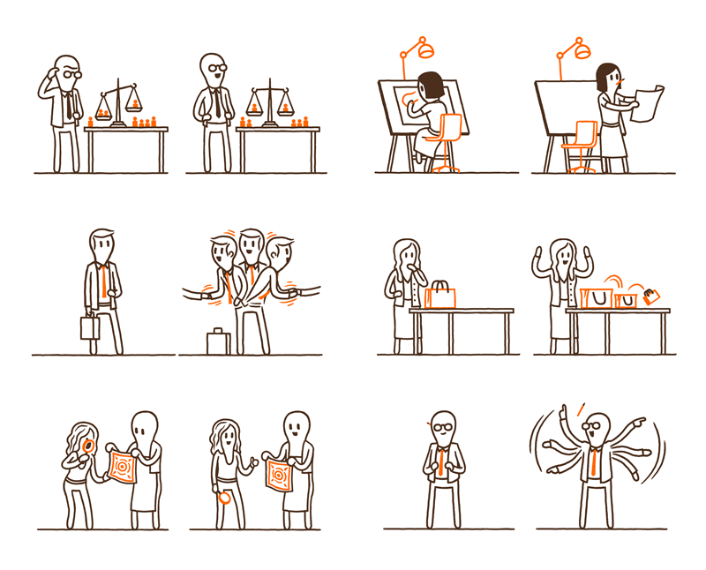
QUALITY ASSURANCE
201 NSF
Support:
Workspace:
1
9 NSF
1
4
192 NSF
3-Drawer Lateral Files:
Workstation:
Quality assurance managers play a crucial role in business by ensuring that products meet certain thresholds of acceptability. They plan, direct or coordinate quality assurance programs and formulate quality control policies.
Quantity:
Area:
Capacity
Quantity:
Area:
Cabinets for storage.
Desktop computer terminal.
Needs:
FF&E:
Acoustical and some visual privacy. More task than natural lighting. Proximity to Purchasing, Operations, Sales, and Marketing.
Desks, computers, lamps, chairs, workstations, cabinets, screen, outlets, water and coffee station.
OPERATIONS
PURCHASING
MARKETING
ACCOUNTING
SALES
QUALITY
ASSURANCE

Slide 11
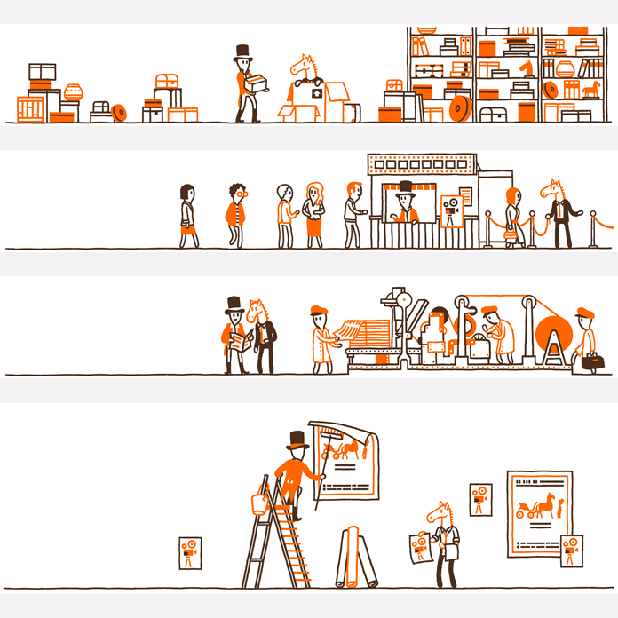
PURCHASING
414 NSF
Workspace:
Support
1
7
336 NSF
2
18 NSF
Purchasing is the organized acquisition of goods and services on behalf of the buying entity. Purchasing activities are needed to ensure that needed items are obtained in a timely manner and at a reasonable cost. A purchasing department is especially necessary in a manufacturing business, where large amounts of raw materials and components must be obtained on a recurring basis.
Workstation:
3-Drawer Lateral Files:
Capacity
Quantity:
Area:
Quantity:
Area:
Desktop computer terminal.
Cabinets for storage
4
1
60 NSF
Collaboration Area:
Capacity
Quantity:
Area:
Place for people to work together toward a common goal.
FF&E:
Needs:
File cabinets, desks, chairs, couch, coffee and water area, outlets, screen, board, computers, lamps, phone, long tables, workstation.
Good lighting, could be natural and task light. Easy access to phone and computers, and space for collaboration.
OPERATIONS
PURCHASING
MARKETING
ACCOUNTING
SALES
QUALITY
ASSURANCE

Slide 12
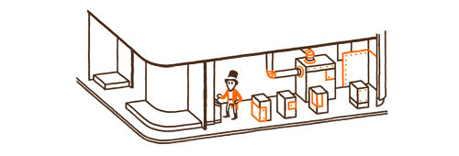
MARKETING
579 NSF
Support:
Workspace:
1
9 NSF
1
1
150 NSF
3-Drawer Lateral Files:
Office:
Marketing management is the process of developing strategies and planning for product or services, advertising, promotions, sales to reach desired customer segment.
Quantity:
Area:
Capacity
Quantity:
Area:
Cabinets for storage.
A room used as a place for commercial, professional, or bureaucratic work.
1
80 NSF
Photo Studio:
Quantity:
Area:
1
5
240 NSF
Workstation:
Take, develop and print photographs
Capacity
Quantity:
Area:
1
100 NSF
Print & Collating Area:
Quantity:
Area:
Desktop computer terminal.
Print and arrange pages in a specific order.
Needs:
FF&E:
Acoustic privacy. Visual privacy from the public area. Dark space for photo studio. Flexibility to have private spaces, as well as space for groups and presentations.
Desks, chairs, couches, workstation, cabinets, water station, outlets, computers, printers, scanners, task lighting, screens, cameras, backgrounds.
OPERATIONS
PURCHASING
MARKETING
ACCOUNTING
SALES
QUALITY
ASSURANCE

Slide 13
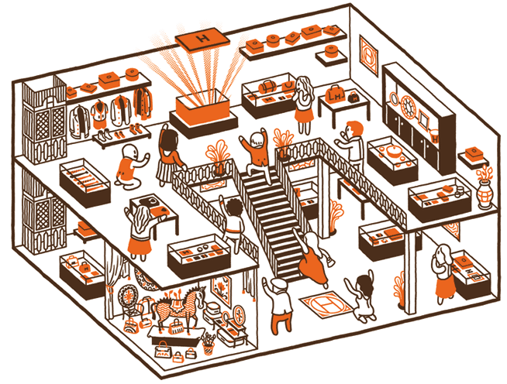
SALES
Workspace:
Support
2
18 NSF
Office:
1
1
150 NSF
3-Drawer Lateral Files:
Capacity
Quantity:
Area:
Quantity:
Area:
858 NSF
Cabinets for storage
4
1
60 NSF
A sales department is the direct link between a company's product or service and its customers. It also advises the marketing department based on its feedback with customers and focuses on customer contact to drive sales.
A room used as a place for commercial, professional, or bureaucratic work.
Collaboration Area:
Capacity
Quantity:
Area:
4
4
144 NSF
14
14
336 NSF
Workstation 2 & 3:
Place for people to work together towards common goal.
Capacity
Quantity:
Area:
Hoteling:
2
2
36 NSF
Desktop computer terminal
Capacity
Quantity:
Area:
Short-term provision of office space to temporary worker.
FF&E:
Needs:
File cabinets, desks, chairs, couches, coffee and water area, outlets, TV’s, computers, lamps, workstation, long tables, phone,
Acoustical privacy. Private spaces, as well as spaces to work in collaboration. Proximity to Marketing department.
OPERATIONS
PURCHASING
MARKETING
ACCOUNTING
SALES
QUALITY
ASSURANCE

Slide 14
CAFÉ
Purpose:
FF&E:
900 NSF
Promotes well-being by keeping employees and visitors hydrated and nourish. Creates communities, and serves as a space to disconnect.
Tables, chairs, couches, coffee tables, microwaves, outlets, water and coffee station, pantry.
Space to eat, drink and socialize.
DAYCARE
700 NSF
FF&E:
PURPOSE:
daytime care for the needs of children.
Tables, chairs, couches, TV’s, boards, playhouse, water station.
Promote the value of the company called “women and men”, which supports both genders to growth equally, by giving a space to their children for employees to be able to keep growing professionally.
PHONE BOOTH
Purpose:
FF&E:
20 NSF
Give the employee extreme privacy.
Desk, chair, lamp, phone, outlet.
Room designed for one person to answer private calls.

Slide 15
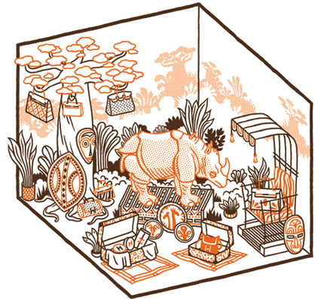

STORAGE ROOM
120 NSF
FF&E:
PURPOSE:
Furniture is stored.
Shelves.
To storage or hide furniture that is not being used. This allows spaces to have more flexibility.
HUDDLE ROOM
Purpose:
FF&E:
200 NSF
Provide privacy.
Table, chairs, screen, outlets.
Small and private meeting area.
FOCUS ROOM
160 NSF
FF&E:
PURPOSE:
Market research method that brings together 6-10 people in a room to provide feedback regarding a product
Desks, tables, chairs, outlets, screens, water station.
Be able to give clients an outstanding product based on real opinions.

Slide 16
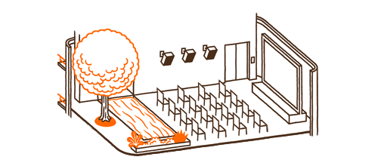
COLLABORATION
Purpose:
FF&E:
120 NSF
Promote well-being by creating small communities. This will improve creativity and boost moral.
Table, couches, chairs, outlets.
Space that allows workers to collaborate with using devices that are wireless, real-time annotation and file sharing
CONFERENCE ROOM
480 NSF
FF&E:
PURPOSE:
Provided for large singular events such as business conferences.
Long tables, screen, board, desk, chair, outlets.
Promotes acoustic and visual privacy.
CONFERENCE ROOM
Purpose:
FF&E:
300 NSF
Promoted acoustic and visual privacy.
Table, chairs, water and coffee station, outlets, screen, board, lamp.
Provided for smaller events such as meetings.

Slide 17
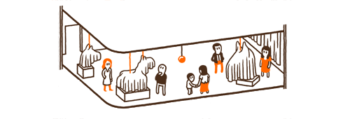
PRINT AREA
100 NSF
FF&E:
PURPOSE:
Where printing takes place.
Computers, printers, scanners.
Creates well-being by having the employees walking to the space. Creates communities.
SERVER ROOM
Purpose:
FF&E:
180 NSF
Promotes technology and innovation.
Desks, chair, computers, outlets.
Room devotes to the continuous operation of computer servers.
HISTORY DISPLAY
Display of the history, most important facts, and values of the company throughout the public spaces of the building.
FF&E:
PURPOSE:
Screens, boards.
Promote the values of the company. use both visual and cultural branding in order to boost moral in the workplace.

Slide 18
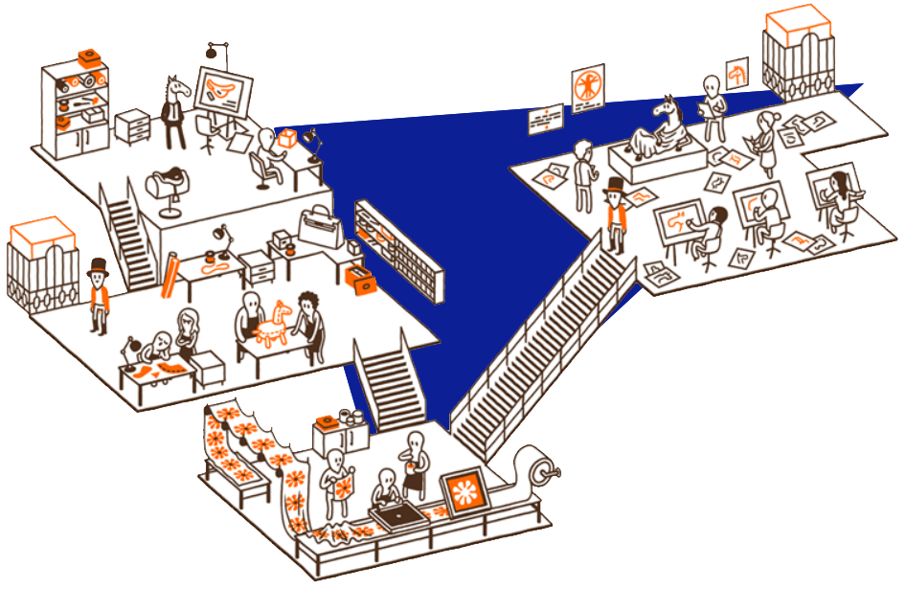
ADJACENCY
DIAGRAMS

Slide 19
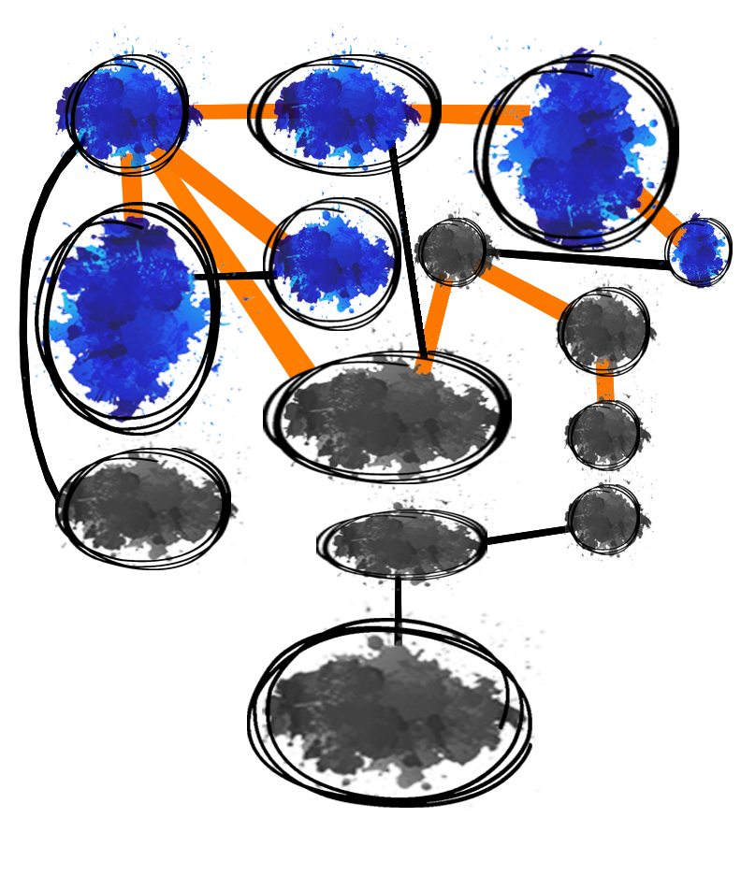

FIRST
LEVEL
WAITING
AREA
LOBBY
CAFÉ
The public spaces of the workplace will be situated on the first level (or second floor of building). However, some private spaces will also be located on this level since they should be reachable to employees and guests visiting the workplace.
PRINT
AREA
COLLABO
RATION
DAYCARE
STAIRS
I.T.
PUBLIC VS. PRIVATE:
H.R.
SERVER
ROOM
Public Areas
Private Areas
FOCUS
ROOM
STORAGE
ROOM
CONFERENCE
ROOM
PRIMARY VS. SECONDARY:
Primary Connection
Secondary Connection
CONFERENCE
ROOM
LIGHT:
Natural Light

Slide 20
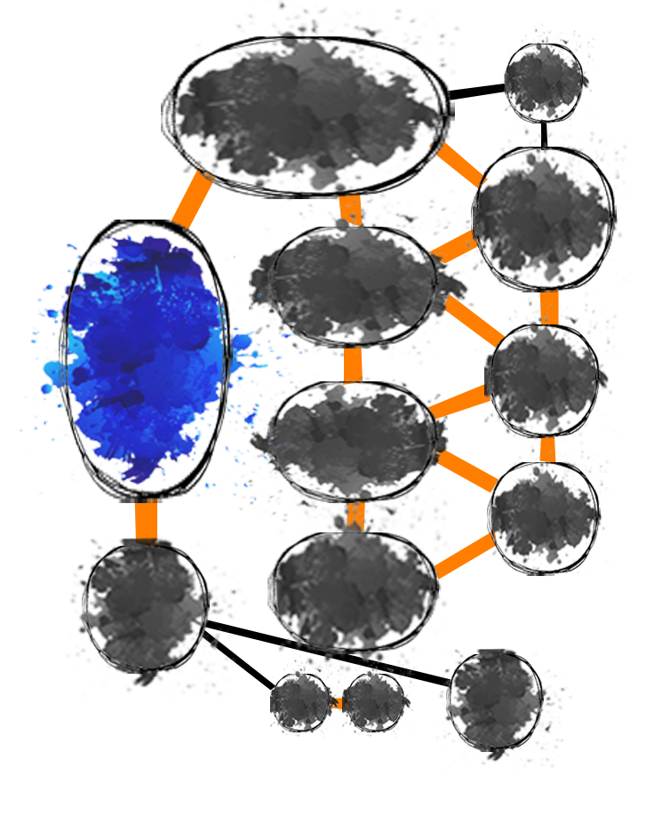
SECOND
PRINT
LEVEL
EXECUTIVE
OFFICES
OPERATIONS
The second level (or third floor of building) will consist in the most private areas of the workplace. Spaces that will needs more acoustic and visual privacy and they will have primary connection depending on the departments and how much support they need from each other.
ACCOUNTING
STAIRS
PURCHASING
PUBLIC VS. PRIVATE:
SALES
Public Areas
Private Areas
MARKETING
PRIMARY VS. SECONDARY:
QUALITY
ASSURANCE
HUDDLE
ROOM
Primary Connection
Secondary Connection
PB
LIGHT:
PB
STORAGE
Natural Light

Slide 21

DESIGN
GUIDELINES
1
The main goal for the design is to promote well-being since it has been proven that increases productivity and motivation. It will be achieved by having water stations mostly everywhere, allowance of sunlight, and creating an inviting set of stairs.
2
Sense of community will be allowed thank to the amount of workstations, collaborative spaces, and support spaces such as the café.
3
History of the brand will be displayed throughout the most public areas of the workplace, so new employees and guests can understand the values and traditions of the brand.
4
Space for daycare will be one of the special features of the workplace. It will allow new parents to keep growing in the professional aspect while still taking care of their lives outside work. This will also reinforce one of the most important values of the companies called “Women and Men”.
5
Give hierarchy to the Executive Offices by making it visually accessible to everybody and creating an extra level.

Slide 22
ThomasVieilli.fr
Wikipedia.com
AccountingTools.com
NounProject.com
ConnectingElements.com
Bizfluent.com
SmallBusiness.com
Irrpubic.edu.au
Shopify.com
LovePik.com
KissPng.com
SOURCES

